Slide 1
Game Theory
Web Club, NITK TuxRide 2018

Slide 2
What is Game Theory?
In strategic games, agents choose strategies that will maximize their return, given the strategies the other agents choose.
Our goal is to find a strategy that we can follow to win the game no
matter what the opponent does, if such a strategy exists.

Slide 3
Combinatorial Games
Two-person games
Win-or-lose or tie outcome
A set of positions, including an initial position, and the player whose turn it is to move.
Both players play optimally.
No randomness.
Player with no moves left loses (or other way round).

Slide 4
A simple problem to start with-
https://www.hackerrank.com/challenges/tower-breakers-1/problem
(HackerRank > Algorithms > Game Theory > Tower Breakers)

Slide 5
Solution
Special Case:M=1
There is no positive divisor of 1 which is smaller than 1, so there is no possible move to be made when M=1
Because of this, player 2 will always win in this scenario.

Slide 6
When N is Even
Imagine that the towers are separated into two groups having an equal number of N/2 towers in each group.
Whenever player 1 mutates one of the towers from the first group, player 2 can simply copy player 1 's last move and apply it to a tower from the second group.
In this way, player 2 will always have move to make, so player 2 will always win.

Slide 7
When N is odd
Player 1 choses a tower and breaks it down to a height of 1.
This results in N-1 remaining breakable towers, which is an even number.
Because we know that the first player to make a move when there are an even number of towers always loses, we know that player 1 will always win.

Slide 8
WINNING AND LOSING STATES
Winning state: Player will win the game if he plays optimally.
Losing state : Player will lose the game if the opponent plays optimally.
If there is a move that leads from the current state to a losing state, the current state is a winning state, else it is a losing state.
0 is clearly a losing state, since no move possible.

Slide 9
STATE GRAPH
Nodes are the states
Edges are the moves between them
LET US SOLVE ANOTHER SIMPLE PROBLEM!
https://www.hackerrank.com/challenges/game-of-stones-1/problem
(HackerRank > Algorithms > Game Theory > Game Of Stones)

Slide 10
#include <bits/stdc++.h> using namespace std; #define N 109 int main() { int t, n; bool win[N]; //Precomputation win[2] = win[3] = win[4] = 1; win[0] = win[1] = 0; for(int i=5; i<N; i++) { bool ch1 = win[i-2]; bool ch2 = win[i-3]; bool ch3 = win[i-5]; bool ans = ch1 & ch2 & ch3; //If opponent is at a losing state win[i] = !ans; //Then i is a winning state }

Slide 11
//Answering Queries scanf("%d", &t); while(t--) { scanf("%d", &n); if(win[n] == 1) printf("First\n"); else printf("Second\n"); } }

Slide 12
Nim Game

Slide 13
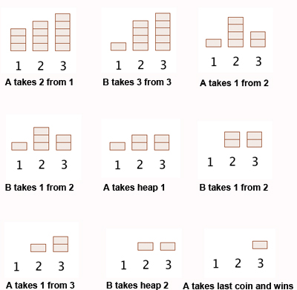

Slide 14
Nim Sum
Nim sum: Nim Sum is the Exclusive XOR of all the elements
XOR properties: - x⊕y = 0 iff x = y - x⊕y ≠ 0 iff x ≠ y
Winning State : Nim sum of all the sizes of heap ≠ 0
Losing State : Nim sum of all the sizes of heap = 0

Slide 15
A Strategy to playing optimally
A correct Strategy must ensure the following:
If the game is in a losing state, then the game is forced to move to a winning state, for any choice of a move, unless the game ends.
If the game is in a winning state, then there always exists a move to a losing state.
A person playing at a winning state has to move the game to a losing state, in every move of his/her game, to ensure he/she wins the game.

Slide 16
An example
How to leave a zero nim sum :
Your opponent moves and leaves the following configuration:
Heap 1 : 10 = 1010
Heap 2 : 12 = 1100
Heap 3 : 5 = 0101
NIM SUM = 0011 = 3

Slide 17
What next?
10⊕3 = 9 < 10. Now reduce 10 to 9 :
You leave your opponent with the following configuration:
Heap 1 : 9 = 1001
Heap 2 : 12 = 1100
Heap 3 : 5 = 0101
NIM SUM = 0000 = 0 (Losing State)

Slide 18
Grundy Numbers

Slide 19
Grundy number of a game state is
mex({ g1 , g2 , . . . , gn })
where g1 , g2 , . . . , gn are the Grundy numbers of the states to which we can move. If there are no possible moves in a state, its Grundy number is 0, because mex(𝛷) = 0.

Slide 20
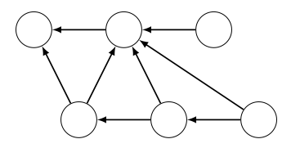

Slide 21
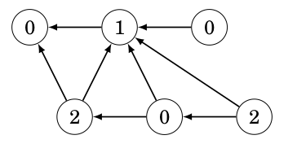

Slide 22
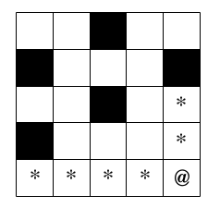
Maze Game

Slide 23
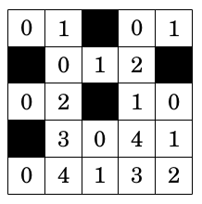

Slide 24
Subgames
This game consists of subgames, and on each turn, a player first chooses a subgame and then makes a move in the subgame. The game ends when it is not possible to make any move in any subgame.
In this case, the Grundy number of a game is the nim sum of the Grundy numbers of the subgames. The game can be played like a nim game by calculating all Grundy numbers for each subgame and then their nim sum.

Slide 25
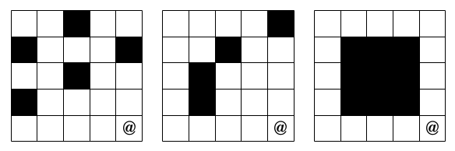
A modification to the Maze Game

Slide 26
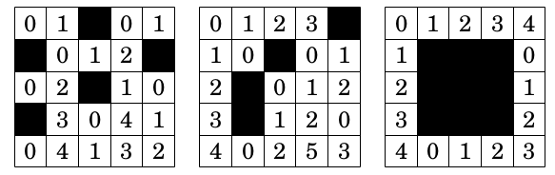
2 ⊕ 3 ⊕ 3 = 3
0 ⊕ 3 ⊕ 3 = 0

Slide 27
Grundy’s Game
Initially, there is a single heap that contains n sticks.
On each turn, the player chooses a heap and divides it into two nonempty heaps such that the heaps are of different size.
The player who makes the last move wins the game.

Slide 28
Let f(n) be the Grundy number of a heap that contains n sticks.
For example, when n = 8, the possibilities are (1 + 7), (2 + 6) and (3 + 5), so
f(8) = mex({ f(1) ⊕ f(7), f(2) ⊕ f(6), f(3) ⊕ f(5) })

Slide 29
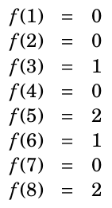
The Grundy number for n = 8 is 2, so it is possible to win the game. The winning move is to create heaps 1 + 7, because
f(1) ⊕ f(7) = 0.

Slide 30
Greedy Coins Problem
You are given with N coins.
Choose one coin from either ends
Maximise the total profit

Slide 31
A can choose 5 or 10
5
3
7
10
A = 0
B = 0

Slide 32
A’s Turn
5
3
7
10
A = 5
B = 0

Slide 33
B’s Turn
5
3
7
10
A = 5
B = 10

Slide 34
A’s Turn
5
3
7
10
A = 12
B = 10

Slide 35
B’s Turn
5
3
7
10
A = 5
B = 13

Slide 36
Greedy Strategy
Pick the highest coin at every step

Slide 37
A’s Turn
8
15
3
7
A = 8
B = 0

Slide 38
B’s Turn
8
15
3
7
A = 8
B = 15

Slide 39
B’s Turn
8
15
3
7
A = 8
B = 15

Slide 40
A’s Turn
8
15
3
7
A = 15
B = 15

Slide 41
A’s Turn
8
15
3
7
A = 15
B = 15

Slide 42
B’s Turn
8
15
3
7
A = 15
B = 18

Slide 43
B’s Turn
8
15
3
7
A = 15
B = 18

Slide 44
Can we do better ???
Meh obviously!

Slide 45
A’s Turn
8
15
3
7
A = 7
B = 0

Slide 46
B’s Turn
8
15
3
7
A = 7
B = 8

Slide 47
A’s Turn
8
15
3
7
A = 22
B = 8

Slide 48
B’s Turn
8
15
3
7
A = 22
B = 11

Slide 49
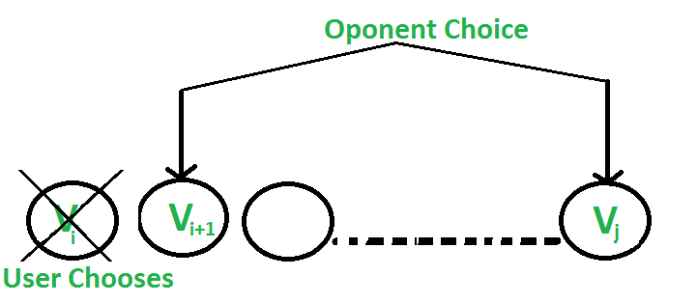
Value for A: F(i, j) = V(i) + Min( F (i+2, j), F(i+1, j-1) )

Slide 50
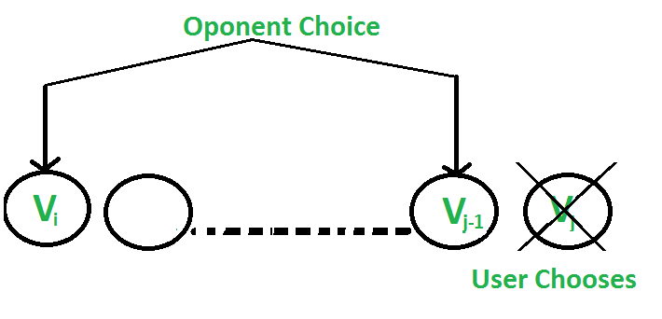
Value for A: F(i, j) = Vj + Min( F(i+1, j-1), F(i, j-2) )

Slide 51
A Recursive Solution
F(i, j) represents the maximum value the user can collect from i'th coin to j'th coin - both inclusive
Base Cases: F(i, j) = Vi If j == i F(i, j) = max(Vi, Vj) If j == i+1 Recursive: F(i, j) = Max(Vi + min(F(i+2, j), F(i+1, j-1) ), Vj + min(F(i+1, j-1), F(i, j-2) ))
Compute each F(i, j) only once for good optimizations.

Slide 52
What did we look at?
A simple problem to start off
State graph, winning and losing states
Nim Game, its strategy, and why it works
Grundy Numbers and subgames
Greedy Coins Problem

Slide 53
Thank You

